Slide 1
The main measurement endeavor with which I am associated is…
Provides annually updated information about government respect for 14 (soon to be 20+) internationally-recognized human rights from 1981 to 2009 in 195 countries
Users can download data free at: www.humanrightsdata.org
Users can create and store customized Excel datasets
Co-Founders/Directors:
David L. Cingranelli David L. Richards
Binghamton University University of Connecticut

Slide 2
Measuring Human Rights is the assignment of numeric ratings to national governments assessing the level of conformity by those governments with international standards for the protection of various human rights.
Policies
Practices
Conditions
Notes:
Eminent Philosopher of science Thomas Kuhn noted that the vitality of a scientific field can be judged by examining the quality of its measurement
HR measurement has come a long way since Lars Schulz (1980)

Slide 3
Metrics are Important for
monitoring state human rights practices,
building theories about the causes and consequences of human rights practices,
assessing the human rights impacts of public policies.

Slide 4
Some Research Questions
What human rights are most and least respected?
How have degrees of respect for various human rights changed, on average, over time?
Is there a relationship between violations of (or respect for) human rights and rebellion?

Slide 5
More Research Questions
Has the spread of democracy and rapid economic globalization since the end of the Cold War affected human rights?
Have specific policies such as free trade agreements, bilateral foreign aid and structural adjustment conditions affected human rights?

Slide 6
CIRI Human Rights Measures Currently Available Online
Disappearance
Extrajudicial Killing
Political Imprisonment
Torture
Freedom of Assembly & Association
Freedom of Foreign Movement
Freedom of Domestic Movement
Freedom of Speech
Electoral Self-Determination
Freedom of Religion
Workers’ Rights
Women’s Economic Rights
Women’s Political Rights
Women’s Social Rights (through 2005)
Independence of the Judiciary
Physical Integrity Rights Index
Empowerment Rights Index

Slide 7
To content-code qualitative materials to produce quantitative human rights indicators, cross-nationally, every year, requires systematic* sources of information to mitigate bias
*Information about the same rights, every country, every year
United States Department of State’s annual Country Reports on Human Rights Practices is the most-systematic and comprehensive report available
Amnesty International’s Annual Report is used to cross-check for completeness
News sources used to clarify events

Slide 8
Strengths
Global in scope
Annually updated
Available from 1981-2009
Free and Public Data
Public Coding Guidelines (e.g., full respect for human right X requires….)
Easily replicated (checked)

Slide 9
Limitations?
The interpretation of EVERY human right is contested.
CIRI measures human rights practices—not policies or conditions.
CIRI measures are based on the annual reports issued by the USSD and AI.
Human rights practices of each country are measured against an absolute standard.
Continued availability depends on funding.

Slide 10
Examples of Interpretation of human rights:
What type/length of arrest/incarceration counts as political ‘imprisonment’?
Are deaths from inappropriate use of tasers extrajudicial killings?
If fathers and/or husbands must give permission for adult women to travel internationally, does the government protect freedom of international movement?
If Sharia law is used to adjudicate some criminal cases, do citizens have the right to a fair trial?

Slide 11
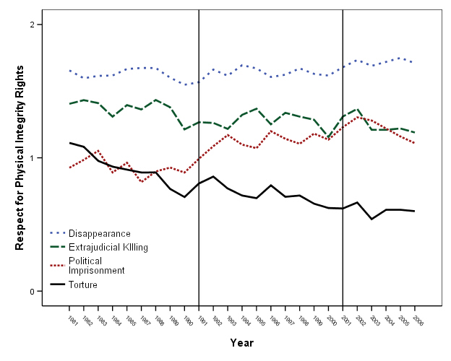
Notes:
Guess which line is which right
What is responsible for this jump?
Africa end of Cold War: In Cameroon, post-Cold War elections failed to bring political succession, but popular pressure led to the release of a significant number of political prisoners. In 1990, in conjunction with events in Eastern Europe, citizen pressure on the Cameroon government to democratize was steadily growing.
The government responded by arresting 11 opposition leaders in February 1990, and then killing six others while violently breaking up a democratic rally. In December of the same year, the national assembly voted to stop -the government's authority to deny legal status to opposition groups.
In 1992, there was a release of prisoners in exchange for the end of a villes mortes campaign (make ghost towns by general strikes) waged by advocates of democracy. Following elections in 1992, the government freed 176 political prisoners in 1993 to ease post-election tensions. These tensions were largely a result of the government's continuing- refusal to hold a national conference, and President Biya's re-election. Biya had been the head of government in one form or another since 1975, and Western observers accused Biya of manipulating the balloting.
3. Why the decline?
SAP (-), Nat leg elects (+), portfolio investment (+), domestic conflict (-)

Slide 12
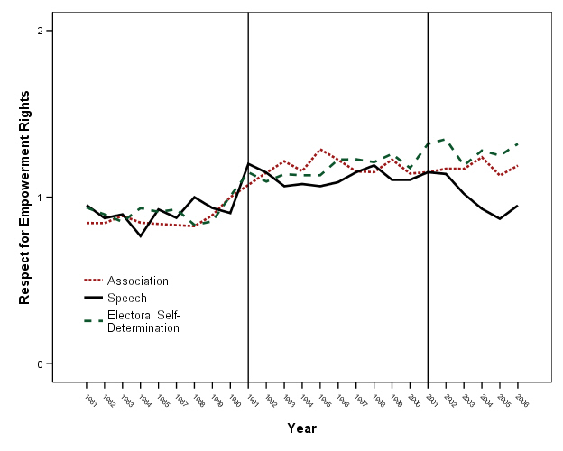
Global Mean Level of Respect for Three Empowerment Rights, 1981-2006
Association
Electoral Self-Determination
Speech

Slide 13
Where do we go from here?
Add measures of more internationally recognized human rights including:
Economic, Social, and Cultural Rights
Human Trafficking
Right to a fair trial
Specific Worker Rights (Freedom of Association, Collective Bargaining, Minimum Wage, Healthy and Safe Workplace, etc.).
Include separate measures of strength of laws and practices.
Notes:
Any kind of anniversary invites both reflection AND speculation

Slide 14
Thank you.

