Slide 1
Leukemia: A Mathematical Model
Katie Sember
Liz Bolduc
Jenna George
Kim Kesting
SPWM 2011

Slide 2
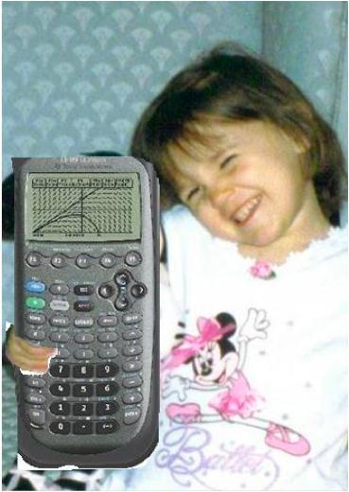
Liz Bolduc
Holy Cross ’12
Zodiac Sign: Leo
Favorite Math Class: Principles of Analysis
Favorite Math Joke:
What’s the integral of 1/cabin?
Log(cabin)
No, a boat house! You forgot to add the C!

Slide 3
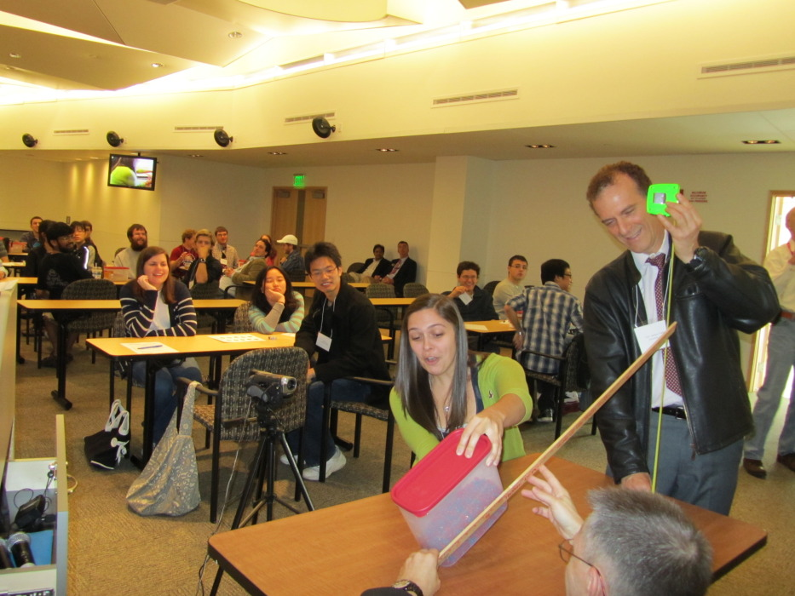
Katie Sember
Buffalo State College ’12
Zodiac Sign: Gemini
Favorite Math Class: Abstract Algebra
Favorite Math Joke:
What’s purple and commutative?
An abelian grape!

Slide 4
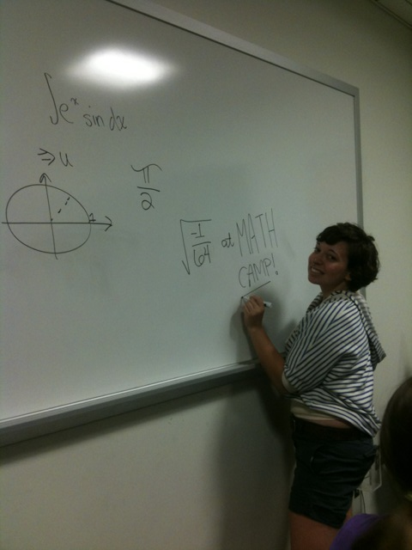
Jenna George
William Paterson University ‘12
Zodiac Sign: Sagittarius
Favortie Math Class: Group Theory
Favorite Math Joke: The number you have dialed is imaginary, please rotate your phone by 90º and try again.

Slide 5
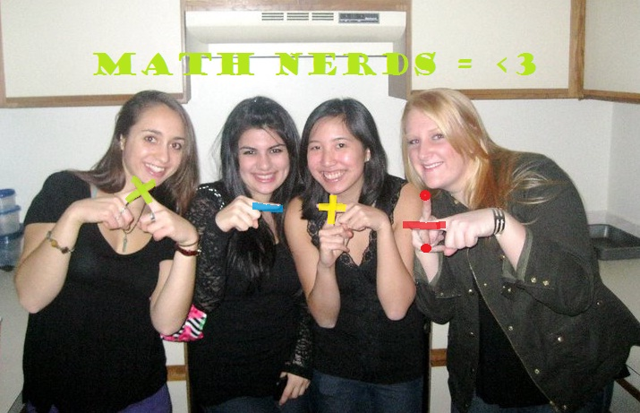
Kim Kesting
Fairfield University ‘12
Zodiac Sign: Pisces
Favortie Math Class: Real Anaylsis
Favorite Math Joke:
A mathematician is asked by a friend who is a devout Christian, “do you believe in one God?” He answers,
“Yes, up to isomorphism.”

Slide 6
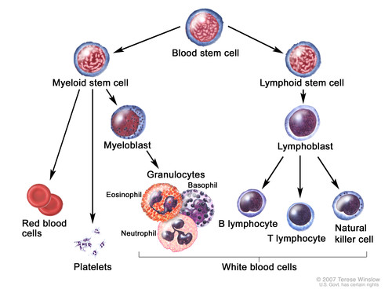
Chronic Myelogenous Leukemia (CML)
Bone marrow makes blood stem cells that develop into either myeloid or lymphoid stem cells.
Lymphoid stem cells develop into white blood cells.
Myeloid Stem cells develop into 3 types of blood cells:
Red Blood Cells- carry oxygen and other materials to tissues
Platelets- help prevent bleeding by causing blood clots
Granulocytes (WBC)- fight infection and disease

Slide 7
Chronic Myelogenous Leukemia (CML)
In CML, too many stem cells turn into granulocytes that are abnormal and do not become healthy white blood cells.
Referred to as Leukemia cells
These Leukemia cells build up in blood and bone marrow leaving less room for healthy cells and platelets.
This leads to infection, anemia, and easy bleeding.

Slide 8
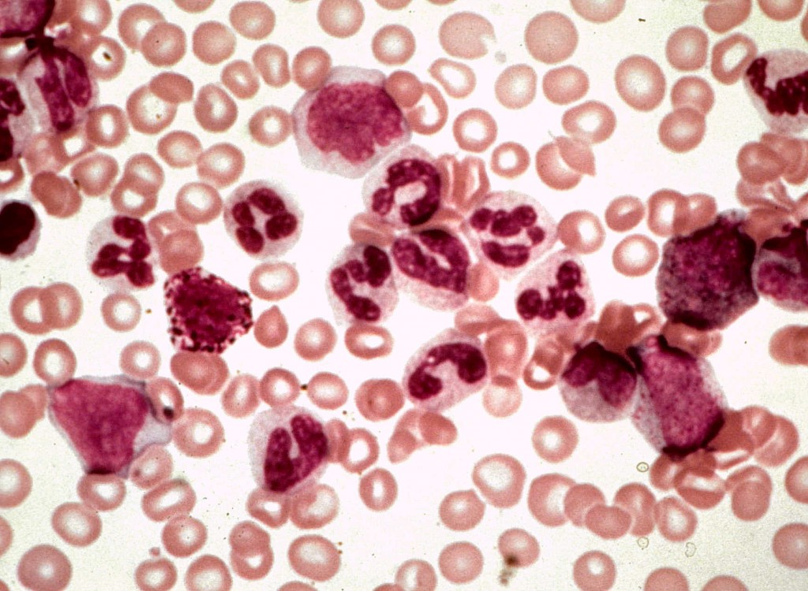
Periodic Chronic Myelogenous Leukemia (CML)
Typically, the production of blood cells is relatively constant.
In diseases such as CML, the growth of white blood cells is uncontrolled and can sometimes occur in an oscillatory manner.

Slide 9
Goal of Modeling
To discover the site of action of the feedback that controls blood cells growth and that can lead to growth in oscillatory manner.
We can do this by using a Delay Differential Equation!!

Slide 10
Why a DDE?
We want to study the change in the total number of cells in the blood stream
New cells are always being produced and/or dying – these are the changes we want to take into account.
However, cell production in the bone marrow takes time. The number of cells secreted at a certain time is in relation to the number of cells in the blood stream some time t – d ago. This is our delay!

Slide 11
Our Basic DDE Model
Change in total number of cells at time t
Density of cells at their maximum age
Density of brand new cells
Cells that die before maximum age

Slide 12
Adding a New Function into the Mix
Consider a new function, F, that is a production function related to the rate of secretion of growth inducer in response to the blood cell population size.
From this equation, we see that the total number of new cells in the bloodstream is a result of the total number of cells that were in the bloodstream t – d days ago.

Slide 13
Our New DDE Model
In this case, F is the number of new cells produced in relation to the number of cells present at time t – d – X days ago.
Cell survival probability
F is a function that produces new cells based on the total number of cells that were present in the blood stream t – d days ago.

Slide 14
Our DDE Model
The number of cells that reach the maximum age and die
Brand new cells that have just left the bone marrow and entered the bloodstream
The number of cells that die before reaching maximum age.

Slide 15
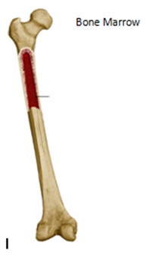
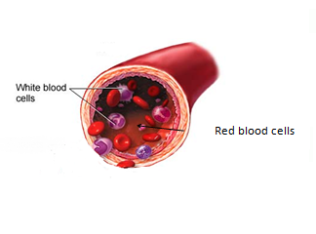
$$F(N)$$
Population of Blood Cells
$$F(N\left(t−d−X\right))e^{−βt}$$
$$F(N\left(t−d\right))$$
$$N$$
$$βn$$
$$\frac{dN}{dt}=F\left(N\left(t−d\right)\right)$$
$$−F(N\left(t−d−X\right))e^{−βt}$$
$$−βn$$

Slide 16
Linearization of our DDE
In order to determine stability of our delay differential equation, we first linearize the equation around the steady state solution N₀.
We are looking for solutions of the form:
N(t)=N₀ + N₀εe^{λt}
y(t) = x – x* or x* + y(t) =x where y(t) = Ke^{λt}

Slide 17
Linearization of our DDE
Now we substitute N(t) into our DDE and take the derivative with respect to N.
For our purposes, we want to consider the case where β = 0. This implies that all cells die exactly at age X.
As the lim β → 0, the characteristic equation becomes:

Slide 18
Determining Stability from Roots
The roots of this characteristic equation determine the stability of the linearized solution.
λ | Stability
Negative real part | Stable
Positive real part* | Unstable
* The only way to have a positive real part is if the solution is a complex number, because F ’(N₀)<0.

Slide 19
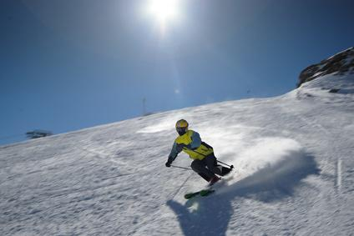
Determining Stability from Roots
If the steady state solution is stable, the return to steady state is oscillatory rather than monotone.
Following rapid distributions of blood cell population, such as traumatic blood loss, or transfusion, or a vacation at a high altitude ski resort, the blood cell population will oscillate about its steady state.
Oh no!

Slide 20
Changes in Stability
The only way to have a root with a positive real part is if the root is complex
Transitioning from stable to unstable can occur only if the complex root changes the sign of its real part.
Hopf bifurcation, where λ=iω.

Slide 21
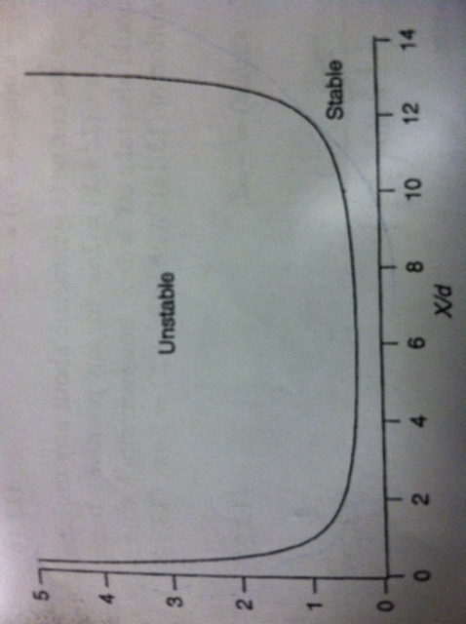
Possible Changes in Stability
We notice a change in stability due to a relationship between
and.
The implications of this relationship are interesting:
If our parameters lie above the curve then the solution is unstable
If the parameters lie below, our solution is stable

Slide 22
What does this mean biologically?
Three mechanisms determine the stability of cell production:
The time it takes for new cells to enter the bloodstream
The expected life expectancy
The rate at which new cells are produced

Slide 23
Changing the Parameters
Recall:
The usually instability occurs when is lower than normal
Thus must increase or must decrease

Slide 24
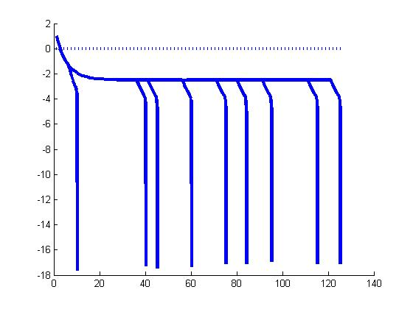
Change in the Delay

Slide 25
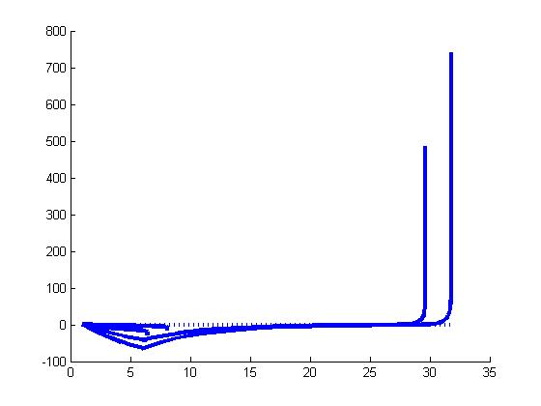
Change in Variable A in Function F(N)

Slide 26
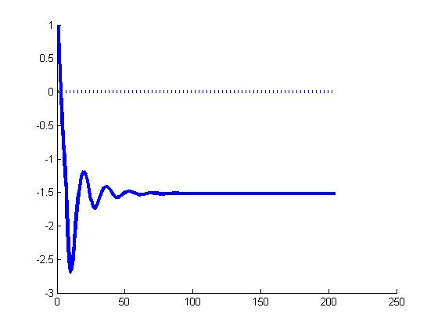
Change in p value in the function F(N)

Slide 27
THANKS FOR A GREAT CLASS ANGELA!!
I Crocodilia!!

